Slide 1

Heart Disease Prediction Using Machine Learning

Slide 2
INDEX
Sr. No. | Content
1 | Introduction
2 | Flowchart
3 | Data Description
4 | Column Description
5 | Algorithm applied Decision Tree Description Support Vector Machine (SVM) Random Forest Description
6 | Graphical representation of result
7 | Final conclusion

Slide 3
INTRODUCTION
Heart disease describes a range of conditions that affect your heart. Diseases under the heart disease umbrella include blood vessel diseases, such as coronary artery disease, heart rhythm problems (arrhythmias) and heart defects you’re born with (congenital heart defects), among others.
The term “heart disease” is often used interchangeably with the term “cardiovascular disease”. Cardiovascular disease generally refers to conditions that involve narrowed or blocked blood vessels that can lead to a heart attack, chest pain (angina) or stroke. Other heart conditions, such as those that affect your heart’s muscle, valves or rhythm, also are considered forms of heart disease.
Heart disease is one of the biggest causes of morbidity and mortality among the population of the world. Prediction of cardiovascular disease is regarded as one of the most important subjects in the section of clinical data analysis. The amount of data in the healthcare industry is huge. Data mining turns the large collection of raw healthcare data into information that can help to make informed decisions and predictions.

Slide 4
FLOWCHART
Start
Heart Disease Dataset
Apply Data pre-processing techniques
Training Set
Training Set
Decision Tree
SVM
Random Forest
Heart disease prediction
Yes
No
Patient has Heart disease
Patient dose not have Heart disease

Slide 5
DATA DESCRIPTION
The dataset consists of 302 individuals data.
There are 14 columns in the dataset. The “target" field refers to the presence of heart disease in the patient. It is integer valued from 0 (no presence) to 4.
Following is the description:
Age: Age is the most important risk factor in developing cardiovascular or heart diseases, with approximately a tripling of risk with each decade of life.
Sex: Men are at greater risk of heart disease than pre-menopausal women. Once past menopause, it has been argued that a woman’s risk is similar to a man’s although more recent data from the WHO and UN disputes this. If a female has diabetes, she is more likely to develop heart disease than a male with diabetes.
Angina (Chest Pain): Angina is chest pain or discomfort caused when your heart muscle doesn’t get enough oxygen-rich blood. It may feel like pressure or squeezing in your chest. The discomfort also can occur in your shoulders, arms, neck, jaw, or back. Angina pain may even feel like indigestion.

Slide 6
4.Resting Blood Pressure: Over time, high blood pressure can damage arteries that feed your heart. High blood pressure that occurs with other conditions, such as obesity, high cholesterol or diabetes, increases your risk even more.
5. Cholesterol: A high level of low-density lipoprotein (LDL) cholesterol (the “bad” cholesterol) is most likely to narrow arteries. A high level of triglycerides, a type of blood fat related to your diet, also ups your risk of a heart attack. However, a high level of high-density lipoprotein (HDL) cholesterol (the “good” cholesterol) lowers your risk of a heart attack.
6. Fasting Blood Sugar: Not producing enough of a hormone secreted by your pancreas (insulin) or not responding to insulin properly causes your body’s blood sugar levels to rise, increasing your risk of a heart attack.
7. Resting ECG: For people at low risk of cardiovascular disease, the USPSTF concludes with moderate certainty that the potential harms of screening with resting or exercise ECG equal or exceed the potential benefits. For people at intermediate to high risk, current evidence is insufficient to assess the balance of benefits and harms of screening.

Slide 7
8.Max heart rate achieved: The increase in cardiovascular risk, associated with the acceleration of heart rate, was comparable to the increase in risk observed with high blood pressure. It has been shown that an increase in heart rate by 10 beats per minute was associated with an increase in the risk of cardiac death by at least 20%, and this increase in the risk is similar to the one observed with an increase in systolic blood pressure by 10 mm Hg.
9. Exercise induced angina: The pain or discomfort associated with angina usually feels tight, gripping or squeezing, and can vary from mild to severe. Angina is usually felt in the center of your chest but may spread to either or both of your shoulders, or your back, neck, jaw or arm. It can even be felt in your hands. o Types of Angina a. Stable Angina / Angina Pectoris b. Unstable Angina c. Variant (Prinzmetal) Angina d. Microvascular Angina.
10. Peak exercise ST segment: A treadmill ECG stress test is considered abnormal when there is a horizontal or down-sloping ST-segment depression ≥ 1 mm at 60–80 ms after the J point. Exercise ECGs with up-sloping ST-segment depressions are typically reported as an ‘equivocal’ test. In general, the occurrence of horizontal or down-sloping ST-segment depression at a lower workload (calculated in METs) or heart rate indicates a worse prognosis and higher likelihood of multi-vessel disease.

Slide 8
COLUMN DESCRIPTION
Age
Sex
Cp
Trestbps
Chol
Fbs
Restecg
Thalach
Exang
Oldpeak
Slope
Ca
Thal
Target
: Age
: Sex
: Chest-pain
: Blood pressure
: Serum Cholestrol
: Fasting Blood Sugar
: Resting ECG
: Max heart rate achieved
: Exercise induced angina
: ST depression induced by exercise relative to rest
: Peak exercise ST segment
: number of major vessels (0-3) colored by flourosopy
: 0 = normal; 1 = fixed defect
: 0 = absence : 1 = presence of disease

Slide 9
DECISION TREE ALGORITHM
A decision tree is a type of supervised machine learning used to categorize or make predictions based on how a previous set of questions were answered. The model is a form of supervised learning, meaning that the model is trained and tested on a set of data that contains the desired categorization.
The decision tree may not always provide a clear-cut answer or decision. Instead, it may present options so the data scientist can make an informed decision on their own. Decision trees imitate human thinking, so it’s generally easy for data scientists to understand and interpret the results.
How Does the Decision Tree Work?
Before we dive into how a decision tree works, let’s define some key terms of a decision tree.
Root node: The base of the decision tree.
Splitting: The process of dividing a node into multiple sub-nodes.
Decision node: When a sub-node is further split into additional sub-nodes.
Leaf node: When a sub-node does not further split into additional sub-nodes; represents possible outcomes.
Pruning: The process of removing sub-nodes of a decision tree.
Branch: A subsection of the decision tree consisting of multiple nodes.

Slide 10
SVM ALGORITHM
SVM or Support Vector Machine is a linear model for classification and regression problems. It can solve linear and non-linear problems and work well for many practical problems. The idea of SVM is simple: The algorithm creates a line or a hyperplane which separates the data into classes.
At first approximation what SVMs do is to find a separating line(or hyperplane) between data of two classes. SVM is an algorithm that takes the data as an input and outputs a line that separates those classes if possible.

Slide 11
RANDOM FOREST ALGORITHM
Random forest is a Supervised Machine Learning Algorithm that is used widely in Classification and Regression problems. It builds decision trees on different samples and takes their majority vote for classification and average in case of regression.
One of the most important features of the Random Forest Algorithm is that it can handle the data set containing continuous variables as in the case of regression and categorical variables as in the case of classification. It performs better results for classification problems.
How Does the Random ForestWork?
Before understanding the working of the random forest we must look into the ensemble technique. Ensemble simply means combining multiple models. Thus a collection of models is used to make predictions rather than an individual model.
Ensemble uses two types of methods:
1. Bagging– It creates a different training subset from sample training data with replacement & the final output is based on majority voting. For example, Random Forest.
2. Boosting– It combines weak learners into strong learners by creating sequential models such that the final model has the highest accuracy. For example, ADA BOOST, XG BOOST

Slide 12
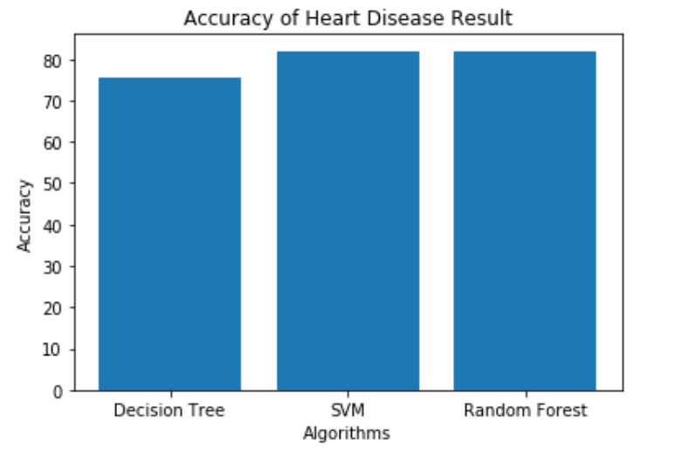
GRAPHICAL REPRESENTATION OF RESULT

Slide 13
CONCLUSION
This involved analysis of heart disease patient dataset with proper data processing. Then, 3 models were trained and tested with maximum scores as follows :
Decision Tree - 75.40%
SVM - 81.96%
Random Forest - 81.96%
From above data we conclude that with the highest accuracy rate SVM and Random Forest Approach is more fitted with the same score.

